Slide 1

Health Chatbot:
Design, Implementation, Acceptance and Usage Motivation

Slide 2
Presented By
VISHNU NAIR
(MES21MCA-2059)
Product Owner
Mr. NOWSHAD CV
Asst. Professor
MES College of Engineering, Kuttippuram
Date : 01.03.2023, Wednesday

Slide 3

CONTENTS
INTRODUCTION
EXISTING SYSTEM
PROPOSED SYSTEM
MODULE DESCRIPTION
SYSTEM REQUIREMENTS
DATA FLOW DIAGRAM
USER STORIES
PRODUCT BACKLOG
PROJECT PLAN
Department of Computer Applications, MES College Of Engineering

Slide 4
INTRODUCTION
The health chatbot application created on the Chatfuel platform. This application allows people to interact with the health chatbot in the same way as they do with other people.
The health chatbot identifies their symptoms through a series of queries and guides them to decide whether or not to go to doctor. Such application can be of great benefit to people who are not sure whether their symptoms are transients or require a response to a doctor for detailed tests.
It also offers advice to users on minor illnesses, and in that way, encourages people to take appropriate measures to stay healthy, which is a great example of promoting a healthy life.
For the purpose of this research, an end-user survey was created and conducted with aim to collect the user’s opinion regarding the acceptance and usage motivation of health chatbot. The results showed good acceptance and usage motivation of health chatbot.
Department of Computer Applications, MES College Of Engineering

Slide 5
EXISTING SYSTEM
The number of people looking for health information is growing dramatically, either it is general health advice or instructions for the patient’s further path through the healthcare system .
There is an awareness of the workload and overbooking of the healthcare system (health care workers, crowds in waiting rooms) .
Health chatbots may speed up processes which means more free time and usefulness for both patients and healthcare professionals.
Also, they may prevent activities that take up too much time for people and bring a minimal outcome (going to the doctor).
Department of Computer Applications, MES College Of Engineering

Slide 6
PROPOSED SYSTEM
The main aim is to design and create a simple health chatbot application, and to explore the acceptability and motivation for its use. This application is a reliable solution that enables efficient, safe, simple and fast provision of basic information about the user's health conditions and guidelines for further procedure.
ADVANTAGES OF PROPOSED SYSTEM
Reduced time on the part of physicians.
Improved security of patient data.
On demand healthcare information.
Accessible and affordable Healthcare information.
Department of Computer Applications, MES College Of Engineering

Slide 7
MODULE DESCRIPTION
ADMIN
Login
Add and manage Expert
View complaint and Send reply
Block or Unblock expert
Add and manage disease
Add and manage home remedies
View rating
EXPERT
Login
Add and manage symptoms
Chat with Users
Add and manage suggestions
Department of Computer Applications, MES College Of Engineering

Slide 8
USERS
Register
Login
View and update profile
Chatbot
Disease prediction
View experts
Chat with experts
View suggestions
View home remedies
Send complaints and view reply
Send rating
Department of Computer Applications, MES College Of Engineering

Slide 9
SYSTEM REQUIREMENTS
HARDWARE REQUIREMENTS
• Processor : i3 or above
• RAM : 4GB or more
• Storage : 500 GB or Above
Department of Computer Applications, MES College Of Engineering

Slide 10
SOFTWARE REQUIREMENTS
• Operating System : Windows 8 or above
• Front End : HTML, CSS, BOOTSTRAP
• Back End : Python, Java
• IDE : Android Studio /JetBrains PyCharm
• Database : MySQL
Department of Computer Applications, MES College Of Engineering

Slide 11
DATAFLOW DIAGRAM
Department of Computer Applications, MES College Of Engineering

Slide 12
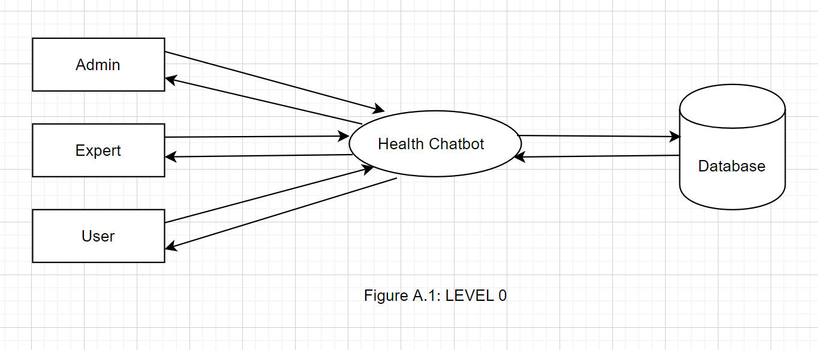
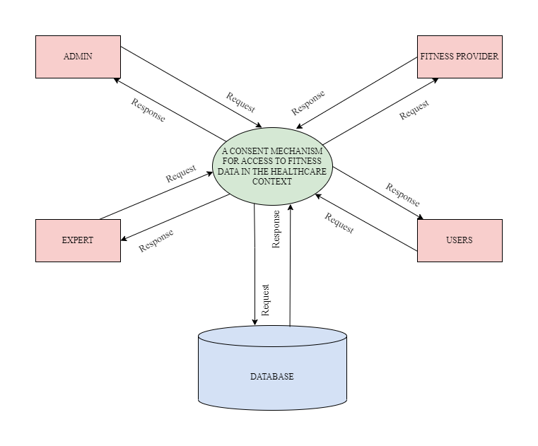
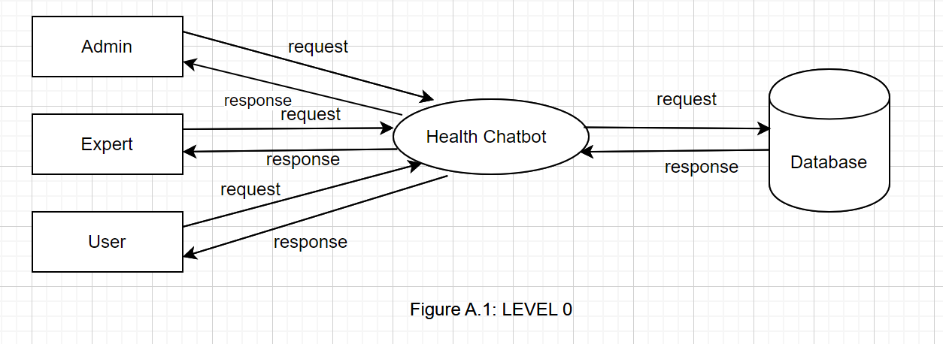
Department of Computer Applications, MES College Of Engineering

Slide 13
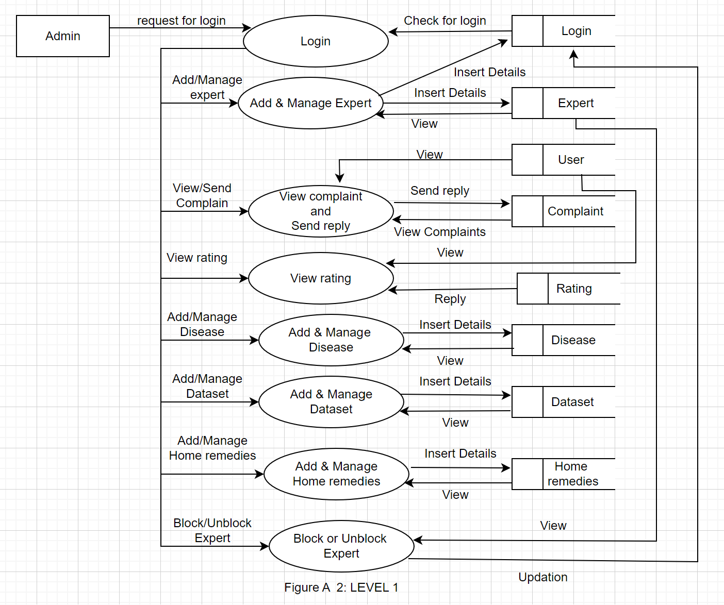
Department of Computer Applications, MES College Of Engineering

Slide 14
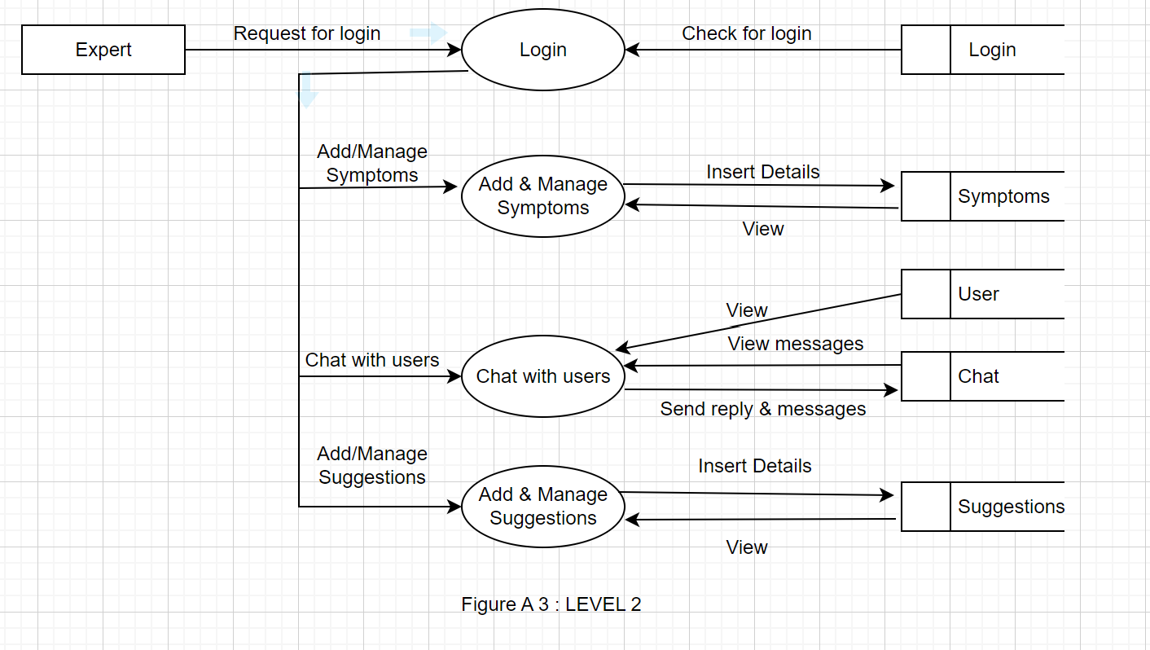
Department of Computer Applications, MES College Of Engineering

Slide 15
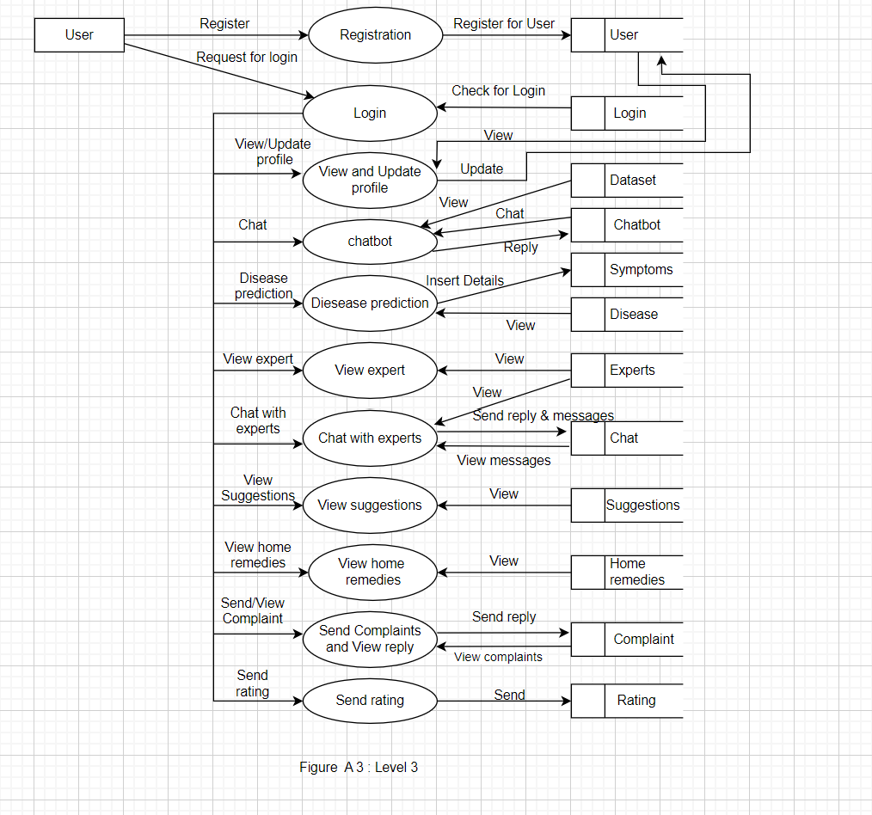
Department of Computer Applications, MES College Of Engineering

Slide 16
USER STORIES
UserStory_ID | As a <type of user> | I want to | So that I can
1 | Admin | Login | Login successful with correct username and password
2 | Admin | Add and manage expert | Manage the expert
3 | Admin | View complaints and send reply | We can view the complaints and send reply
4 | Admin | View rating | Ratings are viewed by the users
5 | Admin | Add and manage disease | Manage the disease
Department of Computer Applications, MES College Of Engineering

Slide 17
UserStory_ID | As a <type of user> | I want to | So that I can
6 | Admin | Add and manage Dataset | Manage the Dataset
7 | Admin | Add and manage remedies | Manage the home remedies
8 | Admin | Block or Unblock Expert | Updation of the expert
9 | Expert | Login | Login successful with correct username and password
10 | Expert | Add and manage symptoms | Add and manage the symptoms
Department of Computer Applications, MES College Of Engineering

Slide 18
UserStory_ID | As a <type of user> | I want to | So that I can
11 | Expert | Chat with users | Users can view chat and reply
12 | Expert | Add and manage suggestions | Manage the suggestions
13 | Users | Registration | Create a profile
14 | Users | Login | Login successful with username and password
15 | Users | View and Update profile | View and update user
Department of Computer Applications, MES College Of Engineering

Slide 19
UserStory_ID | As a <type of user> | I want to | So that I can
16 | Users | Chatbot | Send messages and view reply
17 | Users | Disease Prediction | Insert Details to symptoms and view the Disease.
18 | Users | View expert | View the expert
19 | Users | Chat with experts | Viewed by the experts, send and view the messages
20 | Users | View suggestions | User can view the suggestions
Department of Computer Applications, MES College Of Engineering

Slide 20
21 | Users | View home remedies | User can view the home remedies
22 | Users | Send complaints and view reply | Send and view complaints
23 | Users | Send rating | Send the rating
Department of Computer Applications, MES College Of Engineering

Slide 21
PRODUCT BACKLOG
UserStory_ID | Name | Priority
1 | Login for admin | High
2 | Add and manage expert | High
3 | View complaints and send reply | High
4 | View rating | Medium
5 | Add and manage disease | Medium
6 | Add and manage Dataset | Medium
7 | Add and manage remedies | Medium
Department of Computer Applications, MES College Of Engineering

Slide 22
8 | Block or Unblock Expert | Medium
9 | Login for expert | High
10 | Add and manage symptoms | Mediun
11 | Chat with users | High
12 | Add and manage suggestions | High
13 | Registration for users | High
14 | Login with users | High
15 | View and Update profile | Medium
16 | Chatbot | High
17 | Disease Prediction | High
Department of Computer Applications, MES College Of Engineering

Slide 23
18 | View expert | High
19 | Chat with experts | High
20 | View suggestions | Medium
21 | View home remedies | Medium
22 | Send complaints and view reply | Medium
23 | Send rating | Medium
Department of Computer Applications, MES College Of Engineering

Slide 24
PROJECT PLAN
UserStory_ID | Sprint | StartDate | EndDate | Day | Status
1 2 3 4 5 6 | Sprint 1 | 07/02/2023 | 28/02/2023 | 22 | Planned
7 8 9 10 11 | Sprint 2 | 01/03/2023 | 15/03/2023 | 15 | Planned
Department of Computer Applications, MES College Of Engineering

Slide 25
UserStory_ID | Sprint | StartDate | EndDate | Day | Status
12 13 14 15 16 17 | Sprint 3 | 16/03/2023 | 16/04/2023 | 32 | Planned
18 19 20 21 22 23 | Sprint 4 | 17/04/2023 | 15/05/2023 | 29 | Planned
Department of Computer Applications, MES College Of Engineering

